Slide 1




Smart Waste Segregation System Using Computer Vision and 4-DOF Robotic Arm
ID6101 - Techniques And Management of E-waste recycling
April 2025
ME22B1072 - UJJWAL RAJ
EC24M1001 - S SREEVIDYA
EC24M1002 - RA SRINETHE

Slide 2
Background/Origin/Road Map
Background:
Traditional waste segregation methods rely heavily on manual labor, which is inefficient and prone to errors. With increasing waste, especially e-waste, there’s an urgent need for automated segregation systems to manage waste efficiently.
Origin:
The concept merges advancements in computer vision and robotics to address the growing challenge of waste segregation.

Slide 3
Road Map
Literature review and feasibility study
Designing and programming the 4-DOF robotic arm for sorting
Optimization and deployment
Phase 1
Phase 3
Phase 5
Phase 2
Phase 4
Development of computer vision algorithms for waste identification
Integration and testing

Slide 4
Introduction
The Smart Waste Segregation System aims to revolutionize waste management by using state-of-the-art technology in computer vision and robotics.
It automates the process of sorting waste, particularly e-waste, into different categories for recycling or disposal, reducing human error and labor.
By employing a 4-DOF robotic arm, the system can handle complex sorting tasks with high precision, adapting to various types of waste materials and shapes.
This project not only addresses environmental concerns but also showcases the potential of AI and robotics in tackling real-world problems.

Slide 5
Literature Review - 1
Title of Paper | Journal Published in | Summary | Inference
Multi-class Waste Segregation Using Computer Vision and Robotic Arm | PeerJ Computer Science | The paper presents a waste segregation system using YOLOv5 for object detection and a robotic arm for waste sorting. The system classifies dry waste (paper, plastic, metal, glass) with 80% accuracy. The hardware includes Raspberry Pi and Jetson Nano. | AI and robotics can significantly enhance waste segregation accuracy and automation, reducing manual labor.
[1] Lahoti, J., Sn, J., Krishna, M. V., Prasad, M., BS, R., Mysore, N., & Nayak, J. S. (2024). Multi-class waste segregation using computer vision and robotic arm. PeerJ Computer Science, 10(e1957). https://doi.org/10.7717/peerj-cs.1957

Slide 6
Literature Review - 2
Title of Paper | Journal Published in | Summary | Inference
Intelligent Waste Classification System Integrating Deep Learning and Robotic Arm Technology | 8th International Conference on Electronic Information Technology and Computer Engineering (EITCE 2024) | The system uses DenseNet121 for image classification and a robotic arm for sorting. Data augmentation techniques improve model accuracy. The study evaluates different deep learning models for efficiency. | Deep learning with optimized architectures like DenseNet121 improves waste classification, making AI-driven automation more reliable.
[2] Duan, Y. (2024). Intelligent waste classification system integrating deep learning and robotic arm technology. In Proceedings of the 2024 8th International Conference on Electronic Information Technology and Computer Engineering (EITCE 2024), October 18–20, Haikou, China. ACM. https://doi.org/10.1145/3711129.3711229

Slide 7
Literature Review - 3
Title of Paper | Journal Published in | Summary | Inference
An Automated Waste Management System Using Artificial Intelligence and Robotics | Journal of Material Cycles and Waste Management | A CNN-based classification system with a robotic arm achieves 99% success in waste sorting. Uses SSD-MobileNetV2 for object detection and a wireless network for system control. Data augmentation improves classification accuracy. | Lightweight AI models like SSD-MobileNetV2 enable real-time waste classification, making them suitable for embedded and IoT applications.
[3] Le Quang Thao. (2023). An automated waste management system using artificial intelligence and robotics. Journal of Material Cycles and Waste Management, 25(4), 3791–3800. https://doi.org/10.1007/s10163-023-01796-4

Slide 8
CURRENT SCENARIO
According to the Global E-Waste Monitor 2024, it has been stated that in 2022, 62 million metric tons of e-waste were generated worldwide, and this is expected to reach 82 million metric tons by 2030, growing at a rate of 2.6 million tons per year.
Usually, the e-waste generated in well-developed countries is exported to developing countries such as India, Nigeria, Malaysia, etc.
90% of e-waste in these developing countries is processed informally, meaning there is no advanced technology or proper factory setup to handle e-waste disposal.
Instead, e-waste is dumped in landfills, where people manually collect and segregate it.

Slide 9
In 2022, it was observed that around $91 billion worth of recoverable materials were present in global e-waste (Urban Mining – The Future of Raw Materials, UNEP, 2023).
But only 22% of this was recovered through formal channels (like factories), and the rest was lost through informal recycling, landfilling, or incineration.
This manual process is highly inefficient and hazardous since most of the waste in landfills are bunt which in turn release toxic gases.
Separation of e waste from the rest of the waste in the preliminary stages will help in sending them to appropriate factories where further processing can be done safely and efficiently.
This calls for an automated technique wherein E-waste can be safely separated from the rest without manual interference.

Slide 10
OVERVIEW OF THE ROBOTIC ARM
Our system features the Pro-Range ESP32 Robotic Arm with Web Control Kit, a highly adaptable and programmable solution designed specifically for automation applications.
Key Features:
- Degrees of Freedom: The arm utilizes a 4-DOF configuration, allowing for comprehensive movement across base rotation, shoulder, elbow, and gripper joints.
- Servo Motors: It is equipped with four servo motors, each providing a rotation range from 0° to 180°, ensuring precise articulation for various tasks.

Slide 11
- Control Interface: The integrated ESP32 microcontroller offers Wi-Fi connectivity, enabling effortless web-based control and programming capabilities.
- Web-Based Control: Users can conveniently operate the arm via a browser interface, removing the necessity for additional software installations.
- Material and Build: Constructed from robust components, this robotic arm is ideal for educational and prototyping applications.
Integration in Our Project: Within our smart waste segregation system, this robotic arm is integrated with a computer vision module. Once e-waste items are accurately classified, the arm receives commands to efficiently pick and place objects into designated categories, facilitating automated sorting.

Slide 12
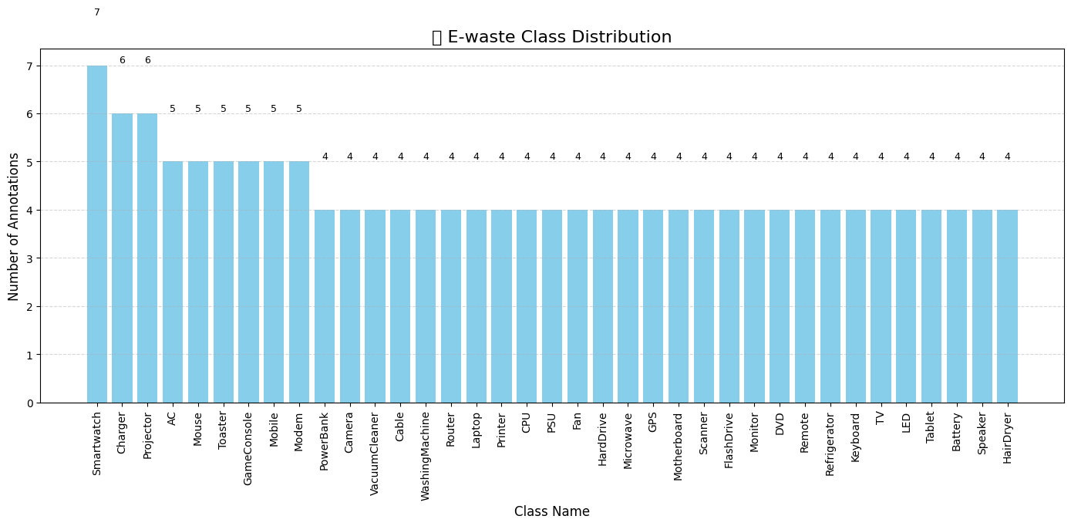
Development of Computer Vision Model for E-Waste Identification
Dataset: Used a balanced e-waste dataset from Roboflow containing 36 electronic waste classes with labeled bounding boxes; resized for efficient training.
Preprocessing: Removed segmentation annotations to avoid mixed-label issues and ensured a clean object detection format compatible with YOLOv8.
Model: Trained a lightweight YOLOv8n model (Ultralytics 8.3.107) using 370 images on Apple M1 CPU for fast and efficient inference on embedded systems.
Objective: Achieved robust detection performance tailored for integration with a 6-DOF robotic arm for automatic e-waste segregation.

Slide 13
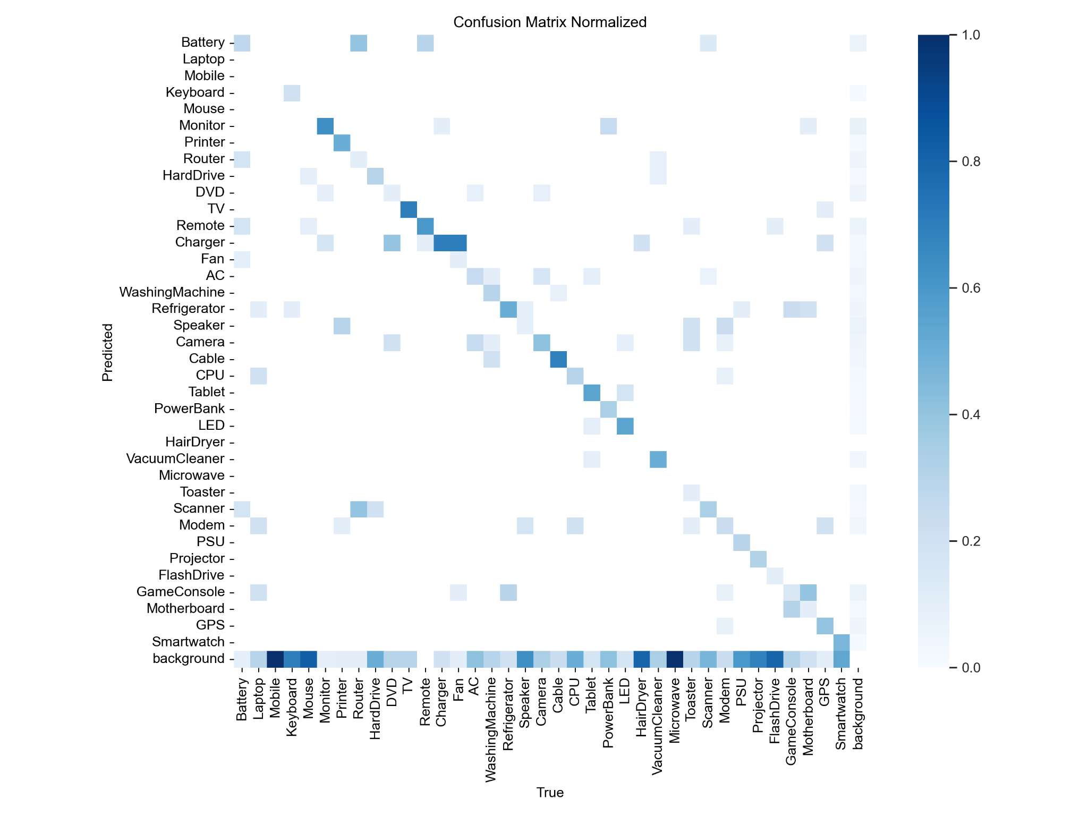
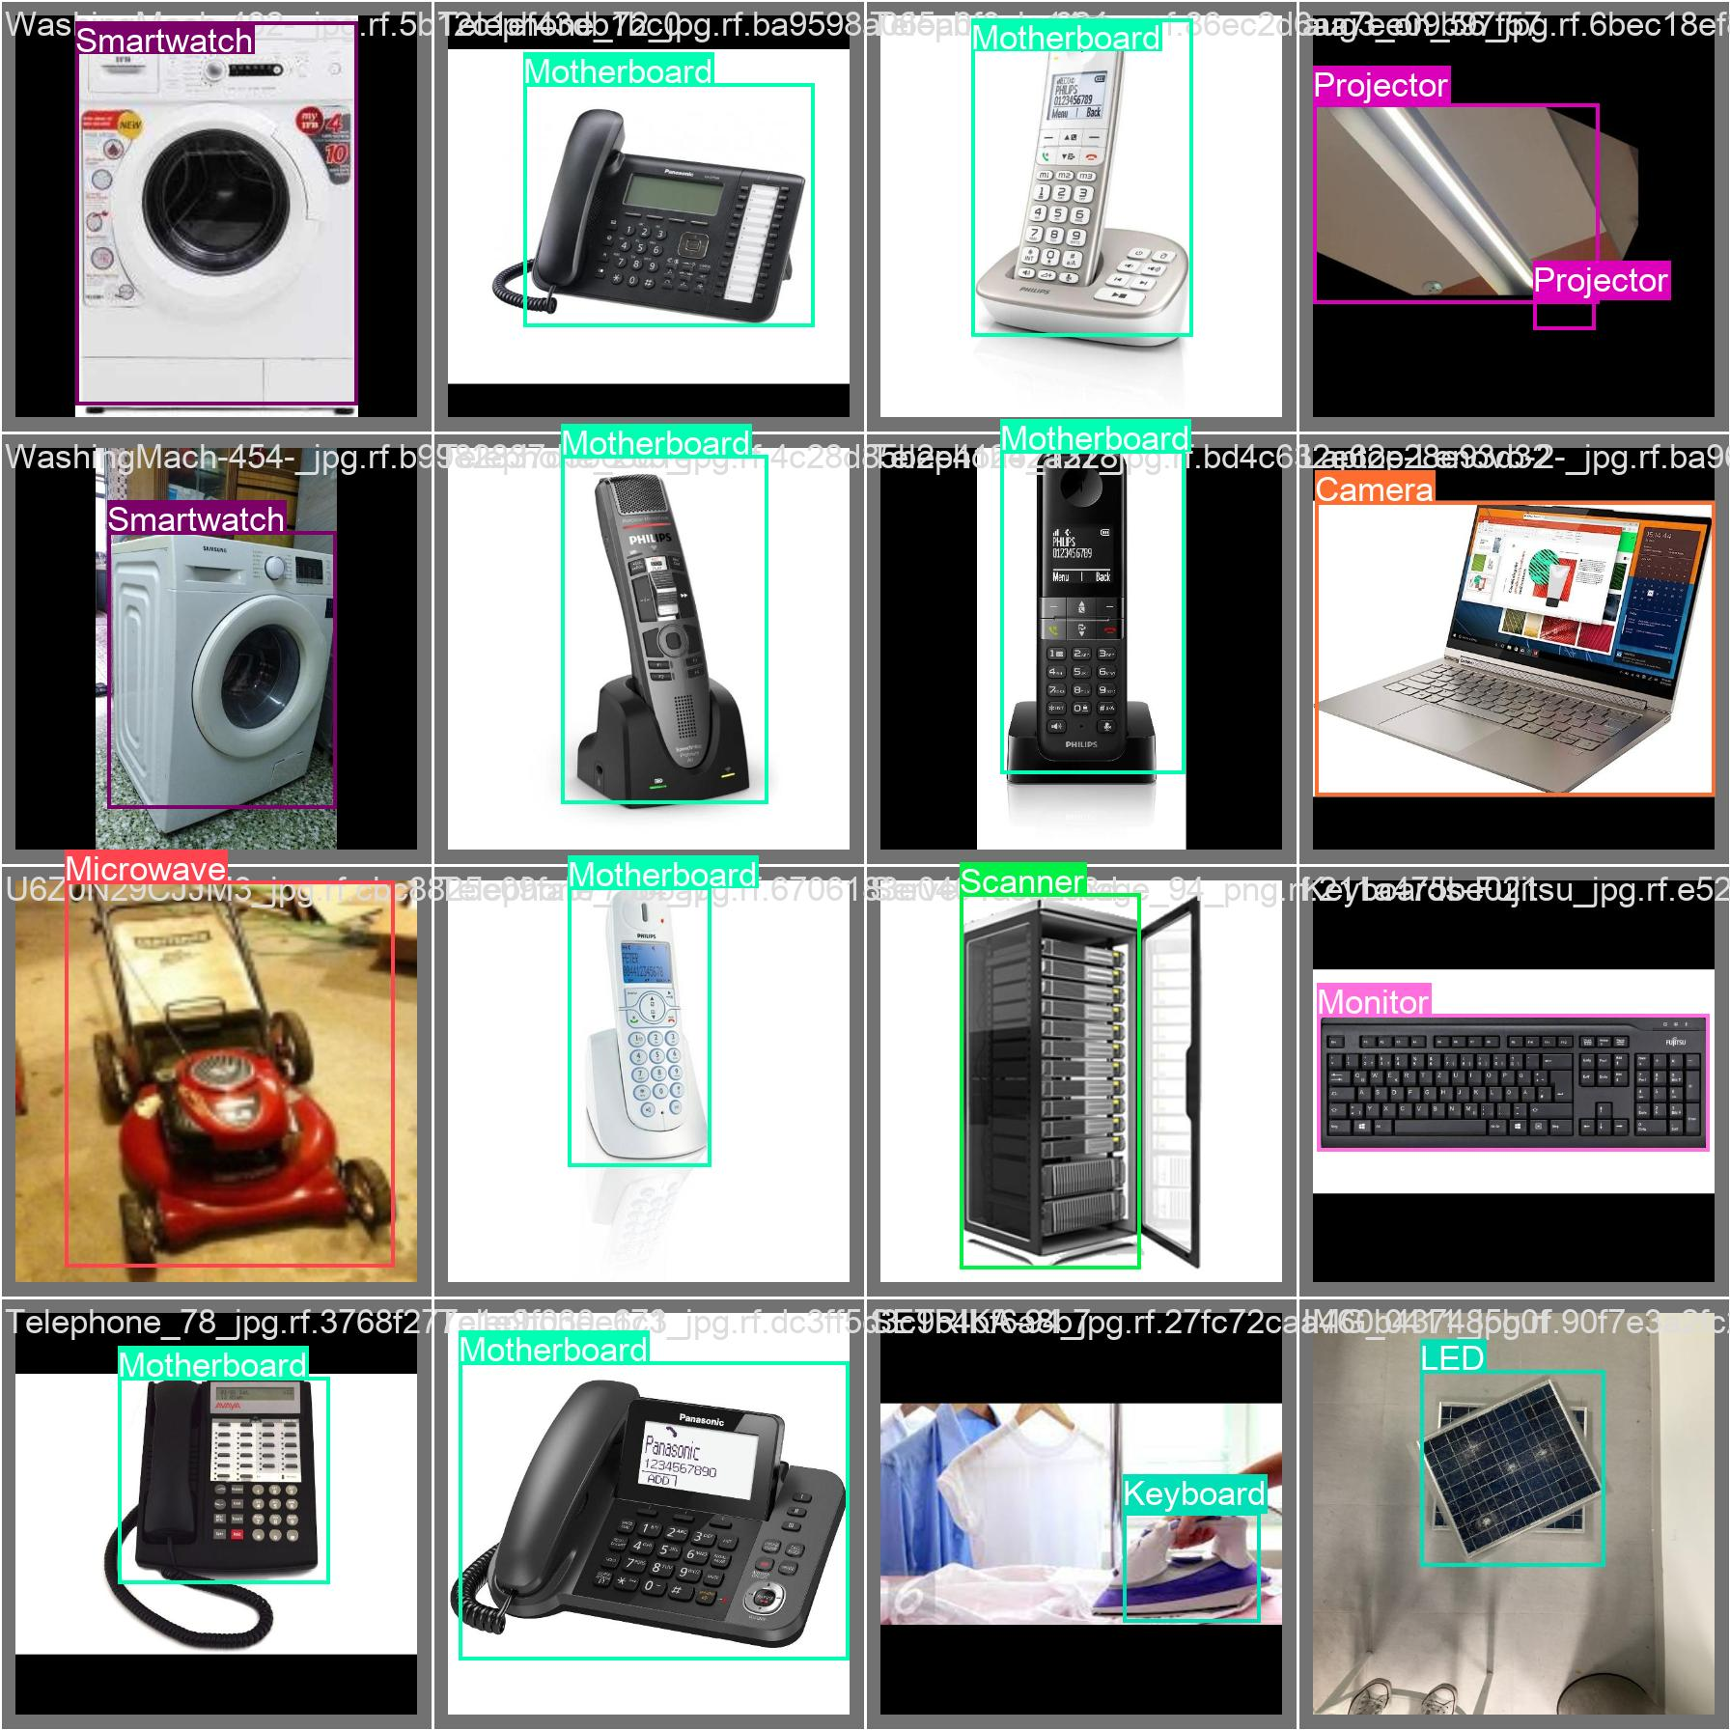
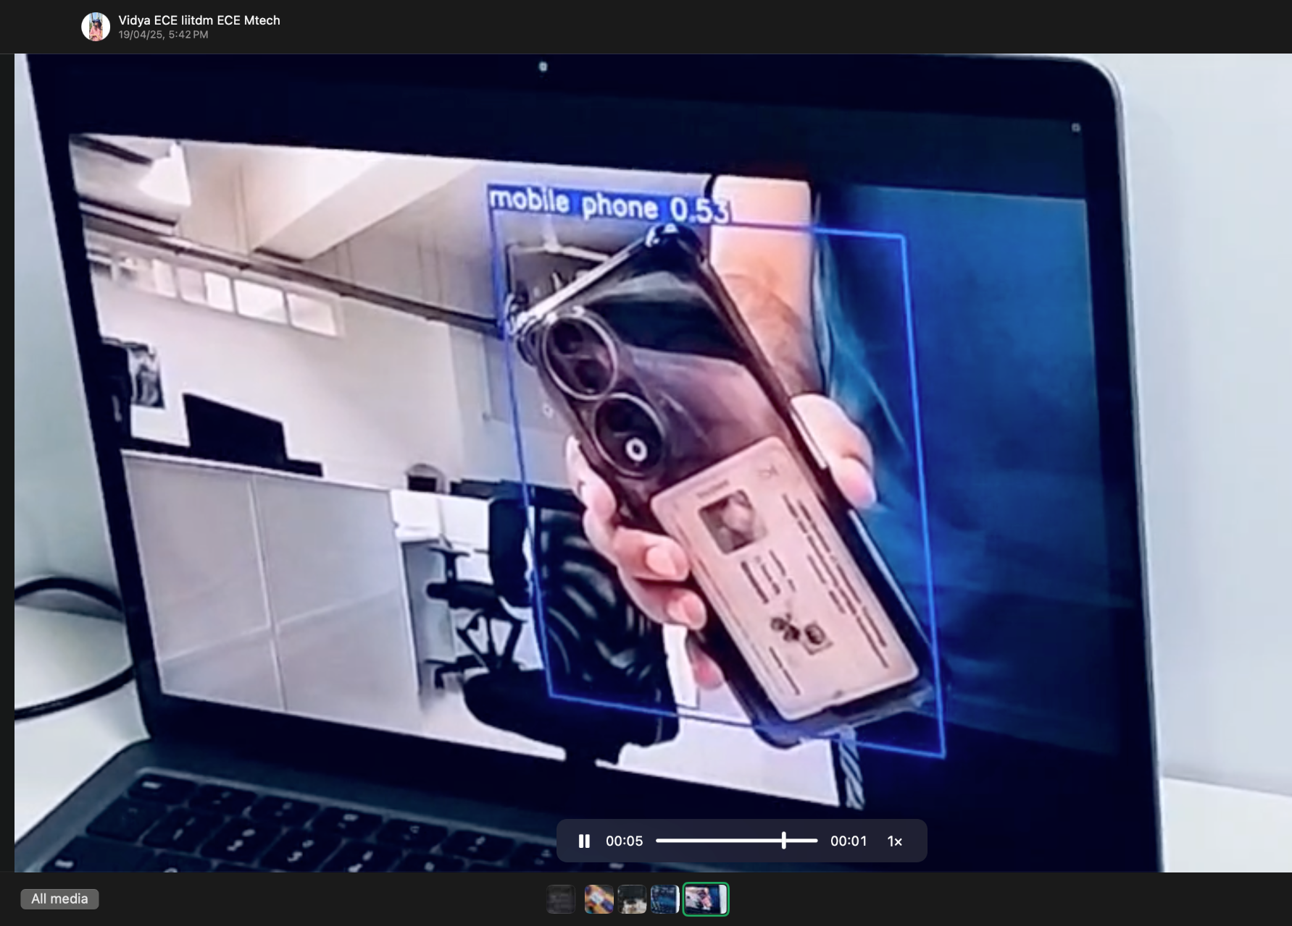
Model Performance
Overall Performance: Achieved mean Precision of 68.4%, Recall of 49.5%, and mAP@0.5 of 55.8%, ensuring reliable detection across 24 e-waste categories.
High Accuracy Classes: Notable classes like Monitor, Router, Fan, and LED showed >85% mAP@0.5, demonstrating strong potential for real-world robotic integration.

Slide 14

DEMO VIDEO RECORDED IN TLC-313

Slide 15
FUTURE DEVELOPMENTS
A real time monitoring app could be developed so that the authorities can keep track of what kind of e-waste is being collected and the amount of e-waste collected in an area.
The set up could be made portable so that it can be used in different locations.
Could be expanded to an end to end E-waste processing unit where the waste is not only separated but also dismantled.

